Slide 1
Kernel – Device Drivers (part 2)
CS 0449
Jarrett Billingsley

Slide 2
Class announcements
this lecture is a little short :) I’m soOOOoOoo sorry :)

Slide 3
How the kernel is extended

Slide 4
Like user mode programs, but not
inside the kernel, there are a lot of little differences.
Stack
there's no C stdlib at all!
you typically also can't use floats.
the stack is tiny.
#include <stdio.h>
stack arrays are a bad idea.
printk("%f", 1.0)
there are only the functions that the kernel provides.
that seems like a weird restriction, but it's to make context switches faster.
so you wanna use the heap… but there's no malloc/free.
printk()
kmalloc()
kfree()
copy_to_user()
float registers are huge, and not saving them saves time.
Notes:
the kernel functions are usually subtly different
e.g. in the Linux kernel, printk requires a "severity" as its first parameter unlike “normal” printf
- context switches mostly involve swapping out the values of all the registers, and float registers, well…
- the AVX-512 registers on modern x64 CPUs total 2 KILOBYTES of data. yeah. not great for performance.

Slide 5
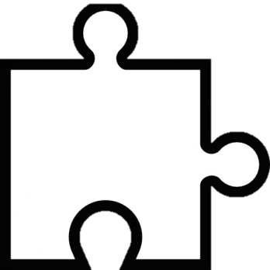
The kernel module lifecycle
kernel modules can be loaded and unloaded at will.
remember, they’re not programs, but libraries.
on load, the module’s “initialize” function is called, in which it creates devices in /dev/, parameters in /sys/, etc.
load
Kernel
unload
then, when user-mode processes access the virtual files it created, the kernel forwards those requests to it.
finally, a module can be unloaded –its “uninitialize” function is called, which lets it clean up the things it created.
Notes:
you might load a module when a device is plugged in, and then unload it when it’s unplugged. that way, only the actually-needed modules stay in memory.
this process is generally true for any modern OS – it’s how Linux, macOS, and Windows all work.

Slide 6
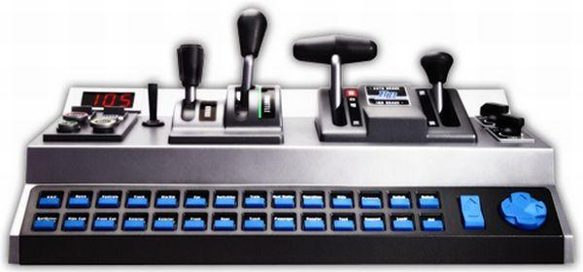
Module dependencies
just like user mode libraries, modules can depend on other modules.
managing these dependencies yourself would be a pain.
a driver for your weird USB game controller will depend on the USB module.
usb.ko
driver.ko
modern OSes have an entire subsystem dedicated to tracking dependencies between modules, so that they can be loaded automatically for you.

Slide 7
Talking to hardware
device drivers exist to control hardware.
most of the hardware is connected to the CPU over a bus – a sort of tiny, fast network inside the computer. these days it’s usually PCIe.
CPU
RAM
Storage
talking to hardware basically means sending commands over the bus.
USB
which commands make the hardware perform which functions is entirely up to the manufacturer!
GPU
Notes:
- it’s funny, everything is turning into PCIe now. USB-C? you can have PCIe over it. DisplayPort? PCIe. Thunderbolt? PCIe.
- it just doesn’t really make sense to do anything else these days. we used to have lots of different buses for different purposes (PCI vs. USB vs. IDE vs. FSB) but they existed mostly because of limitations. these days, those limitations are gone, and it’s just way easier to use one bus for everything.

Slide 8
Excuse me…
sometimes, the hardware does the talking.
this is a hardware interrupt.
doot doot doo, running a process…
Process
CPU
Memory
they're used for very low-latency asynchronous notifications.
aaaa a packet of data came in!!! HANDLE IT NOW!!!
Code
they can only be handled in kernel mode.
OOP nvm, hey network driv--
already on itttt

Slide 9
Or maybe there is no hardware… (slightly animated)
some kernel modules just exist to give user-mode processes limited access to features that can only be done in kernel mode.
processes can’t see each others’ memory, but they can ask a kernel module to send data to another process in a controlled way.
Process 1
Process 2
Memory
Memory
this is called interprocess communication (IPC) and is something we’ll talk about more later!
Code
Code
ipc.ko

Slide 10
User-mode Drivers

Slide 11
Wait, what?
doesn't that seem like a contradiction?
user-mode processes can't access hardware.
...directly. 😜
remember the virtual filesystems?
we can read/write the "files" in /dev/ and /sys/ to control kernel modules
what if we took this further?

Slide 12
Privileges
on a POSIX system, there are many users, and groups of users.
each user group gets privileges: capabilities that other groups may not have.
root can do almost anything.
root
admins have fewer privileges than root, but more than most users.
admins
daemons are "special" processes that run in the background who have higher-than-usual privileges.
daemons
users
privileges like… reading and writing to the files in /dev/ and /sys/!

Slide 13
How user-mode drivers work (animated)
libusb is a common user-mode driver framework.
with it, you can control USB devices from user-mode programs.
3. the user-mode driver handles the request and sends the data back to libusb.
1. a program accesses a software device.
2. the libusb driver forwards the request to the user-mode driver.
User Space (daemon)
User Space (user)
open("/sys/...")
fread(...)
open("/dev/thing")
Kernel
Space
libusb
Syscall handler
4. libusb sends the data back to the original process.

Slide 14
Why would we do this?
remember what was scary about kernel modules?
well, if our user-mode driver is evil or broken…
big deal! so what!
it'll crash, because it's a user-mode process.
your device might stop working, but oh well. restart the driver!
for this reason some OSes are pushing developers towards them.
they're much easier to develop and install.
kernel modules have a lot of limitations, and only system administrators can install them.
in user mode, you can use any language, use any user-mode library, you can debug them in gdb, and compile and run them much more easily.
Notes:
- macOS now requires developers to explain why a kernel module has to be a kernel module; otherwise, it has to be implemented as a user-mode driver.

Slide 15
But of course there are downsides
what'd you notice about that diagram?
how many times did we cross the user/kernel mode barrier?
once to do the original syscall…
once to get up into the driver…
once for the driver to do a syscall…
once for the OS to return to the driver…
once for the driver to return data to libusb…
and once for libusb to return to the original process.
CONTEXT SWITCHES GALORE
this makes them slower than kernel-mode drivers
buuut sometimes it's worth it.
you don't need crazy speed for a thing that blinks a light when you get an email.

Slide 16
Hello, world!

Slide 17
The great journey
it all starts with an idea…
_start:
push rbp
mov fs, xx
mov rdi,
mov esi,
lea edx,
call
as
hm!
cc
blah blah blah a whole bunch more code than you started with lololol
.text
it gets compiled into assembly, then assembled into an object file.
.data
cpp
.bss
.rodata
int main() {
printf("hello, world!\n”);
return 0; }
it gets pre-processed.
it’s then linked with other objects/libraries to make an executable.
ld
libc.a
you write code.
hello
libm.a

Slide 18
Hatching the egg
you run the executable from your shell with ./hello .
the loader loads your executable into that new process’s memory.
Memory
Memory
Memory
Stack
Heap
Globals
Code
bash
bash
./hello
(this is also when dynamic linking happens.)
bash forks…
…and the child process execs to transform itself into your program.
ld
libc.so
hello

Slide 19
In its lane, thriving, moisturized,
after loading, your program starts executing its code. it believes that it has access to all of memory, but it’s a lie.
your program only sees a virtual memory space: some memory addresses are accessible, most are not.
the kernel and loader set up this memory space, and the CPU is what implements and enforces it.
of course, your program can ask for more memory!

Slide 20
Descending the stairs
your program runs in user mode.
but user mode can’t do input or output, so…
it calls printf, a standard library function in the runtime.
that calls write, an OS API….
and that does a syscall.
that switches the CPU into kernel mode, and executes the syscall handler.
User
./hello
printf
Runtime
write
OS API
syscall
Kernel
Syscall Handler

Slide 21
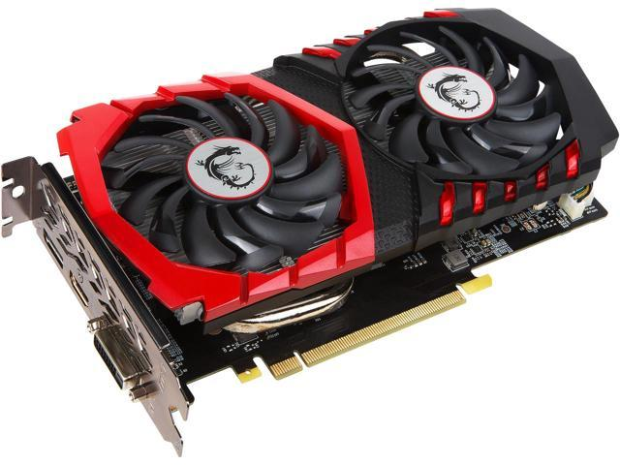
Handling the syscall
how the write syscall is handled really depends on the system, but it goes something like this.
"hello, world!\n\0"
fd | Resource
0 | /dev/pts/117
1 | /dev/pts/117
2 | /dev/pts/117
$ ./hello
hello, world!
$ _
the kernel looks up which file (abstract concept) is being written to, based on the process doing the syscall.
that file is associated with a particular kernel module. it’s given the data to be written.
that module might work with several others to finally, ultimately, command the graphics card to put text onscreen.

Slide 22
This is systems.
systems is about layering abstractions.
systems is about how we make large systems of components that work together in a coherent, unified way.
it’s not just operating systems, either. systems concepts show up in:
databases
large-scale software architecture
distributed systems (i.e. networks)
package management for software
operating systems are just the most common kind of system we interact with on a daily basis!

